Slide 1
.Net Web Developer Essentials

Slide 2
Me
Fran Hoey
@franhoey
fran@bluejumper.com
10 years .Net Developer
6 years Contracting
Organise Chester Devs

Slide 3
The Plan
Session 1
From the browser to the Server and back
Session 2
.Net Magic Explained
General Dev tips
Session 3
Good Code Design (SOLID)
Session 4
Object Oriented Design with CRC Cards

Slide 4
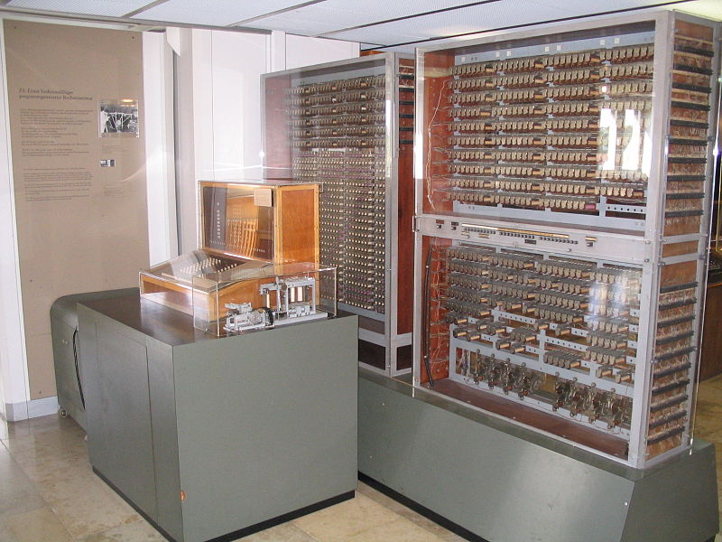
In the beginning….
There was the computer

Slide 5
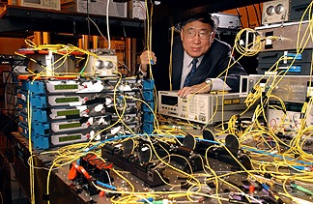
In the beginning….
Then they said let there be communication

Slide 6

In the beginning….
Next they said let the be connected networks

Slide 7

In the beginning….
Finally they said lets create a protocol for client computers to request text data from servers

Slide 8
HTTP
Every internet communication ever uses HTTP
HTTP Request
HTTP Response
Notes:
Irrespective of language, server type, browser, client type, request type

Slide 9
Request
Request Method
Get
Post
Url
Format of Data Accepted (text\html)
Data
Querystring
Post Data

Slide 10
Response
Request Status
200 OK
404 Not Found
302 Moved Temporarily
5xx Error
Content Type (text/html) & Size
Caching policy

Slide 11
Fiddler
Acts as a local proxy
Hijacks all HTTP Requests & Responses
Makes it easy to see what is happening “on the wire”
Notes:
DEMO
200 http://simple.training.local/ - Also Post and Get -
404 http://simple.training.local/nothing.aspx
500 http://simple.training.local/error.aspx
302 http://simple.training.local/from.aspx
Show Request and Response tabs

Slide 12
HTTPS
HTTP is Plain Text
HTTPS is Encrypted using SSL or TLS
Public and Private keys

Slide 13
Internet Information Services

Slide 14
Windows IIS
Windows Web Server
Handler HTTP requests made to the computer
Passes off execution to .Net
Development Computer = Client & Server

Slide 15
Application Pools
The actual application, running on the computer, the website lives in
Visible in Task Manager as w3wp.exe
Basic Settings
.Net Framework Version
Pipeline Mode
Integrated – All requests are processed through asp.net
Classic – Requests to asp.net resources are separate
Advanced settings
Memory management, recycling rules etc
Notes:
Demo creating an Application Pool

Slide 16
Websites
Route HTTP request to the files/application
Bindings (select HTTPs requests to process)
All HTTP requests
Only for a specific domain (Host Headers)
Specifies the Application Pool
Notes:
Create Website

Slide 17
Hosts File
Overrides public DNS on Windows Computers
C:\Windows\System32\drivers\etc
127.0.0.1 simple.training.local
All requests to http://simple.training.local go to local machine

Slide 18
Web Processing
Internet Information Systems (IIS)
Application Pool
Website
HTTP Request
Application Pool
Website
HTTP Response
Website

Slide 19
.Net Request Processing

Slide 20
HttpModules
Execute as part of the processing of the HTTP Request
Implement IHttpModule interface
Enabled in web.config
Hook into specific events of the HTTP Processing
Start & End
Authentication
Cache Processing
Notes:
Show Example Hello Module

Slide 21
Example Usages
Http -> Https switch
Authentication Check
Append Debug data to a page
Add Enforced Http Headers

Slide 22
HttpHandlers
Process the specific request
E.g.
Execute an ASPX page (WebForms)
Execute a Controller Action (MVC)
Process request and return JSON (Custom)
Implement IHttpHandler
Enabled in web.config to handle a specific path
Notes:
Show Http Handler example

Slide 23
Example Usages
Process a download from a database
Quick and dirty API end point
Email processor
Anything that doesn’t require HTML to be returned

Slide 24
Web Processing
Application Pool
HTTP Request
IIS
Http Modules
Http Handler
Http Modules
Http Modules
HTTP Response
Notes:
Show full example

Slide 25
Enter the World of Web Forms

Slide 26
ASPX page Lifecycle
Start
Initialisation
Load
Postback and events
Rendering
Unload
Notes:
Start
Sets IsPostback
Initialisation
Create controls and the control tree
Load
Viewstate is read and applied
Postback and events
If a button was clicked event fires now
Rendering
View state is saved and Render is called on each control
Unload
Finished

Slide 27
ASPX page Lifecycle Events
PreInit, Init, InitComplete
PreLoad, Load,LoadComplete
PreRender, PreRenderComplete
SaveStateComplete
Unload
Notes:
Show Simple.aspx

Slide 28
Enter the World of MVC

Slide 29
Quick Overview
http://{domain}/{Controller}/{Action}/{params}
Controller = Class
Action = Method
http://{domain}/Demo/Simple/12
Controller = Controllers/DemoController.cs
Action = public ActionResult Simple(int id)
View = Views/Demo/Simple.cshtml
Only by default
Notes:
There is no Page

Slide 30
MVC Lifecycle
Routing (configured in Global.asax)
MVC Handler
Controller
Action Execution
View Engine (assuming ActionResult is View)
View (aspx or Razor)
Notes:
Action Result might be anything, JSON, CSV, FileDownload, Redirect
Show Demo – Demo/Simple

Slide 31
WebForms Magic

Slide 32
Masterpages
Just a Template
Content Placeholders provide holes in the template for the page to fill.
Notes:
Show Template Example

Slide 33
Controls
Everything inherits from Control
Pages
User Controls
Web Controls
Custom Controls
Notes:
Show control demo

Slide 34
ASPX
It’s not HTML
ASPX is compiled into a class that inherits the code behind
The code behind inherits Page
Page inherits Control
ASPX = a control (just with different syntax)
Notes:
Mention Renaming problems

Slide 35
ViewState
Stores the state of each Control at the time of Render
Maintains a controls properties on post back and Highlights changes
Big ugly hidden field called __ViewState
DON’T: store large amounts of data in the viewstate
Notes:
Use a drop down control as an example
Populated from a database
Items remain in the list following each post
if selected item changes event fires
Show turn on and turn off
Show HTTP for AutoPostback

Slide 36
MVC Magic

Slide 37
MVC What?
Separation of Concerns
Model
Business logic, only cares about data
View
Display logic, only cares about the user interface
Controller
Traffic Controller, pulls the View and Model together depending on what was asked

Slide 38
_Layout
Just a Template
@RenderBody renders the contents of the view
@RenderSection renders sections from the view
Notes:
Show Template Example

Slide 39
Routing
http://{domain}/{Controller}/{Action}/{params}
Controller = Class
Action = Method
Routes defined in Global.asax
Notes:
Show Global.asax
Show Complex view
Point out ComplexData Model before moving to next slide

Slide 40
Model Binding
Views read from an object
Data posted from a view can be inserted into a model
@Html helpers will produce the HTML for you
@Html helpers aren’t magic, they just make html!
Notes:
Show Model Binding Example
Show html generated by html helpers

Slide 41
Visual Studio

Slide 42
Solutions and Projects
Solution is a just container of projects and files
A project is a DLL
Web Project is a DLL with web files (aspx, css, js)
DLLs can reference other DLLs
Notes:
Show Library demo

Slide 43
Source teaches you more
Try not to use the designer, or at least use split screen
It puts in html that you may not want/need
Drains your html skills
Easy to get in a tangle

Slide 44
Keyboard Shortcuts
Go through the pain for future joy
Ctrl+C, Ctrl+X, Ctrl+V – Copy, Cut, Paste
Ctrl+Shift+B or F6 – Build Solution
F5 – Debug
Ctrl+F5 – Run without Debug (faster)
Shift+Ctrl+F – Advanced Find
Search in solution
Regex
Find Window
Notes:
Explain Ctrl+F5
Demo of Advanced Find – Demo

Slide 45
Debugging
Execute the code line by line
View values of variables
Execute extra code
View the execution history
Notes:
DEMO – Debugging
Autos + Expand
Step In/Step out
Immediate window
Quick Watch

Slide 46
Build Configurations & Debug
By default you have Debug and Release
Debug removes timeouts to allow you to debug!
Never put dlls compiled in debug mode into production
(it’s also set in the web.config)
Notes:
Show debug configurations (mention build/don’t build checkboxes)
Show web.config setting – Explain aspx is compiled

Slide 47
Nuget
Extension to Visual Studio
One command to:
Download, install and configure OSS packages
Update packages
PM> Install-Package elmah

Slide 48
Web.Config
Overrides the machine.config and parent web.configs
configSections
Define xml structures in the web.config
connectionStrings
Database connection string for current environment
appSettings
Config values read at run time
customErrors
Sets the type of error seen by the user
Notes:
configSections – Show Elamh
connectionStrings and appSettings
– show config example
- http://www.connectionstrings.com
customErrors
– put in error, show on and off
- mention custom error pages

Slide 49
Publish
Build -> Publish
File System
Deploys to local machine path
WebDeploy
Builds a package to “install” into IIS
Continuous Integration – deployment king

Slide 50
Source Control

Slide 51
Core Features
Trunk
Is where the core code is
Ideally should match be the code currently live
Branch
Copy of the trunk to make changes on
Usually merged into the trunk once complete
Tag
A point in time we might want to remember (e.g. the version that went live)

Slide 52
Code Commits
Source Control history should show a rich story of the application development
Commit often, comment well
1 commit = 1 change

Slide 53
Ignore Files
Keep you repository clean
Not all files need to be in source control
Common examples
*.suo – per user information
*.user – per user information
Bin – re-built on compile
Obj - re-built on compile

Slide 54
Front End development

Slide 55
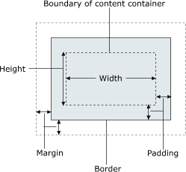
CSS
Everything is a box – CSS Box model

Slide 56
Document Flow
All elements come with out-of-the-box styles
Tables have their own rules
CSS determines how the box relates to each other
Display
Position
Float (and clear)

Slide 57
JQuery
Javascript framework that makes Javascript stupidly easy (if you know how!)
Selectors (the way you select an element)
By tag name $(“div”)
By css class $(“.myclass”)
By id $(“#myId”)
Use Cheat sheets
http://oscarotero.com/jquery/
Notes:
Play in CSS Example

Slide 58
Writing nice code

Slide 59
What is nice code?
Code that you will be able to read and understand easily in 6 months time
Notes:
That’s not the end of it, but it’s a good place to start

Slide 60
What makes code readable
Code is read by scanning
Good Naming
Variables, functions, classes
Small chunks of code
1 method for 1 activity
Group similar tasks into objects (ish)
Consistency – in everything
Notes:
Typically when you read code you don’t want/need to understand every line. You are looking for the one place you need to make a change
Example
Demo bad – change model passed to View

Slide 61
Changeable Code
Writing code is the easy part
Changes are hard
…. all code changes over time
Readable code make is easier
Code designed to minimise the amount of code effected by a change is the holy grail

Slide 62
Uncle Bob’s SOLID
Single Responsibility Principle
Open Closed Principle
Liskov Substitution Principle
Interface Segregation Principle
Dependency Inversion

Slide 63
Single Responsibility Principle
Each class should have only 1 responsibility
Responsibility = “A reason for change”
“An axis of change is only an axis of change if the changes actually occur”

Slide 64
HR System
Employee
CalculatePay() Store()
Return the employee’s pay for the month
Saves changes to a database
Business logic and persistence logic should almost never mixed
Business logic changes frequently
Persistence logic rarely changes
Notes:
Changes are dangerous, they alter the class behaviour. If a class has more than one responsibility, it changes more frequently and
Designed correctly, a change should only impact the contents of the class (providing the class contract is un-changed)
Therefore the less there is in the class the smaller the impact of the change

Slide 65
Open Closed Principle
Don’t modify working code ….. Sort of
Anticipate likely changes to the code
Close of the core code from these changes
Change made through extension rather than modification

Slide 66
HR System
Payroll
PayEmployees(List<Employee>)
Employee
CalculatePay() | Annual Salary/12
Business changes:
Some employees are now paid overtime
Some employees are paid hourly

Slide 67
Options
Edit the CalculatePay() function to cater for all 3 pay schemes
Follow the open closed principle.
Leave the working code as it is
Extend (inherit) employee to create new implementations of CalculatePay()

Slide 68
Open Closed Solution
Payroll
PayEmployees(List<Employee>)
Employee
CalculatePay() | Annual Salary/12
OvertimeEnabledEmployee : Employee
CalculatePay() | Overridden Includes overtime
HourlyPaidEmployee : Employee
CalculatePay() | Overridden Based on hours worked and pay
The fact that CalculatePay() is already removed from the Payroll class shows the designer had anticipated a change like this.

Slide 69
Unit Testing
A unit test is a piece of code that tests a single public function of the application
Grouped together, the whole application is tested in small chunks
Each test should test 1 thing
Employee.CalculatePay returns employee salary/12
The same function should be have a test for each scenario
Don’t test internal implementation of a function.

Slide 70
Why bother?
Aids debugging – a function can be executed without running the whole application
Protects the application from unforeseen side effects of code changes
Adds confidence – If you break something you will be notified.
It speeds up development as bugs are found an isolated quicker.
Notes:
Show example of Employee Tests
Show CalculateUnpaidOvertime isn’t directly tested

Slide 71
Application Design

Slide 72
CRC Cards
Class Responsibility and Collaboration
Application Design brain storming tool
Originally proposed by Kent Beck and Ward Cunningham
Focuses on Class design, not code, db and technology
Can (perhaps should) included business representitives.

Slide 73
What do they look like
Entity Name
Responsibilities | Collaborators

Slide 74
E-Commerce Website Basket
Shopping Basket
Maintain a list of products and quantities Add new products Remove products Alter the quantity of a product Apply discount Calculate Total and Sub Totals | Product Discount Rules

Slide 75
Team Night out planner
Anonymous Users are able to add an event with possible dates for the event to take place.
Other anonymous users can view the dates and previous votes by other users, then add their own name and vote for dates they would prefer.
Example Scenarios
User creates an event with 3 dates
User votes for 2 dates

Slide 76
Team Playlist Controller
Users are able to upload an mp3 file.
Using the file meta data it is added as a track to the team playlist which is visible to the team.
Tracks are played in the order they are added.
Once a track is played it is removed from the playlist.

Slide 77
Team Playlist Controller
Scenarios
A user adds a track
A user adds an track without meta data
A user views the playlist
A track is played
A track has finished playing

Slide 78
Team Playlist Controller
A Change is requested:
Other users are able to vote tracks up or down; tracks with the most votes (or first added if vote counts are equal) will be the next track to be played.
New Scenarios
A Track is voted up
A Track is voted down
A Track is played

Slide 79
Brew Round Application
Authenticated Team members are able request a brew.
Once a request is made a randomly selected team member is sent an email telling them to make a brew round.

Slide 80
Brew Round Application
Scenarios
New Team member joins the brew round
Team member requests a brew
Team member leaves the brew round
Team member changes password
Team member forgets password

Slide 81
Brew Round Application
Change:
Notification method is changed to send text message via an external api. Also Team members on holiday or who made a brew in the last n rounds shouldn’t be selected.
Scenarios
A Brew is requested
Team member requested is on holiday
Team member made a last brew in the last n rounds

Slide 82
Brew Round Application
Change:
Team members are able to rate the brew, or mark it as a no show. Data on the individual team members can be requested by other members.
Scenarios ??

